Slide 1
Jenkins in junit

Slide 2
Contents
How run Jenkins in Junit
Configure Jenkins
Operation of Job
Verify result
Problems

Slide 3
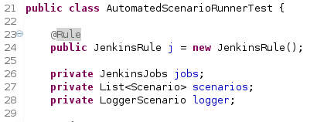
How run Jenkins
Using annotations @Rule causes running Jenkins. Jenkins will created in target.
Sometimes we should run clean and install maven in our project.

Slide 4
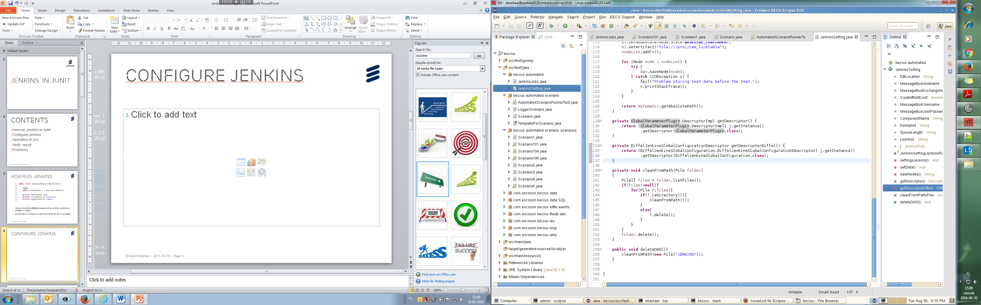
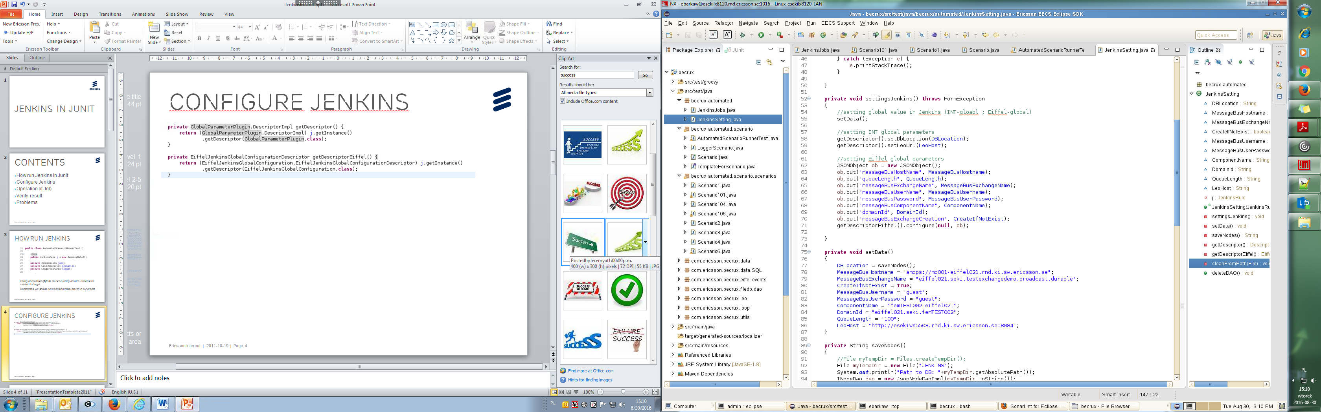
Configure jenkins

Slide 5
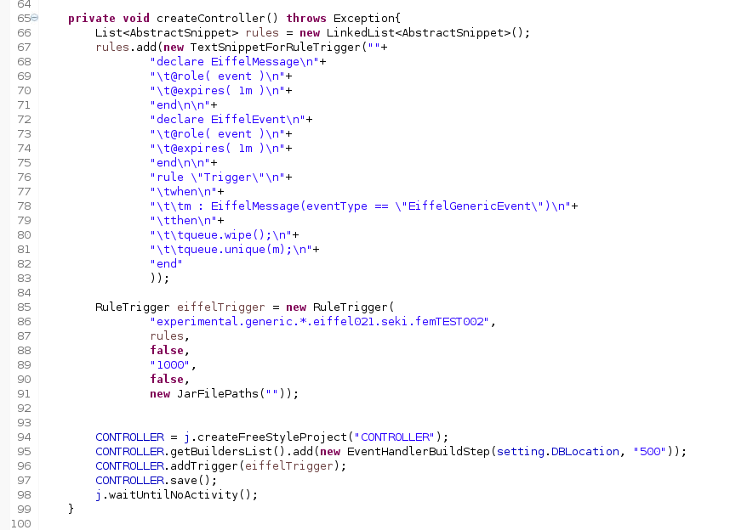
Creating jobs (1)

Slide 6
Creating jobs (2)
In Junit we can configure job just as WebClient
We must remember that Jenkins working in other Thread
After configuration jobs we must save it
Best practices in JenkinsJUnit is using method „waitUntilNoActivity()”
We can access to Jenkins by code but we don’t access by WebBrowser

Slide 7
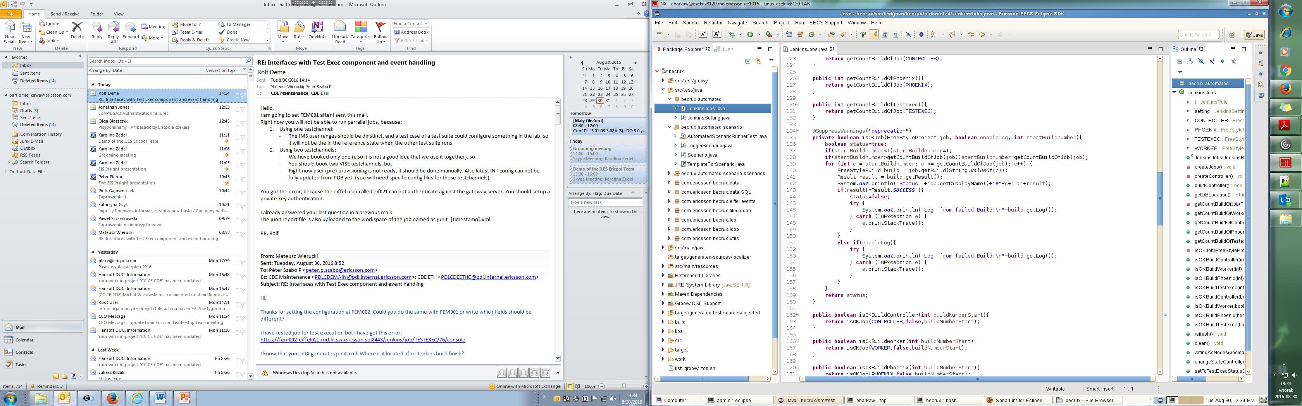
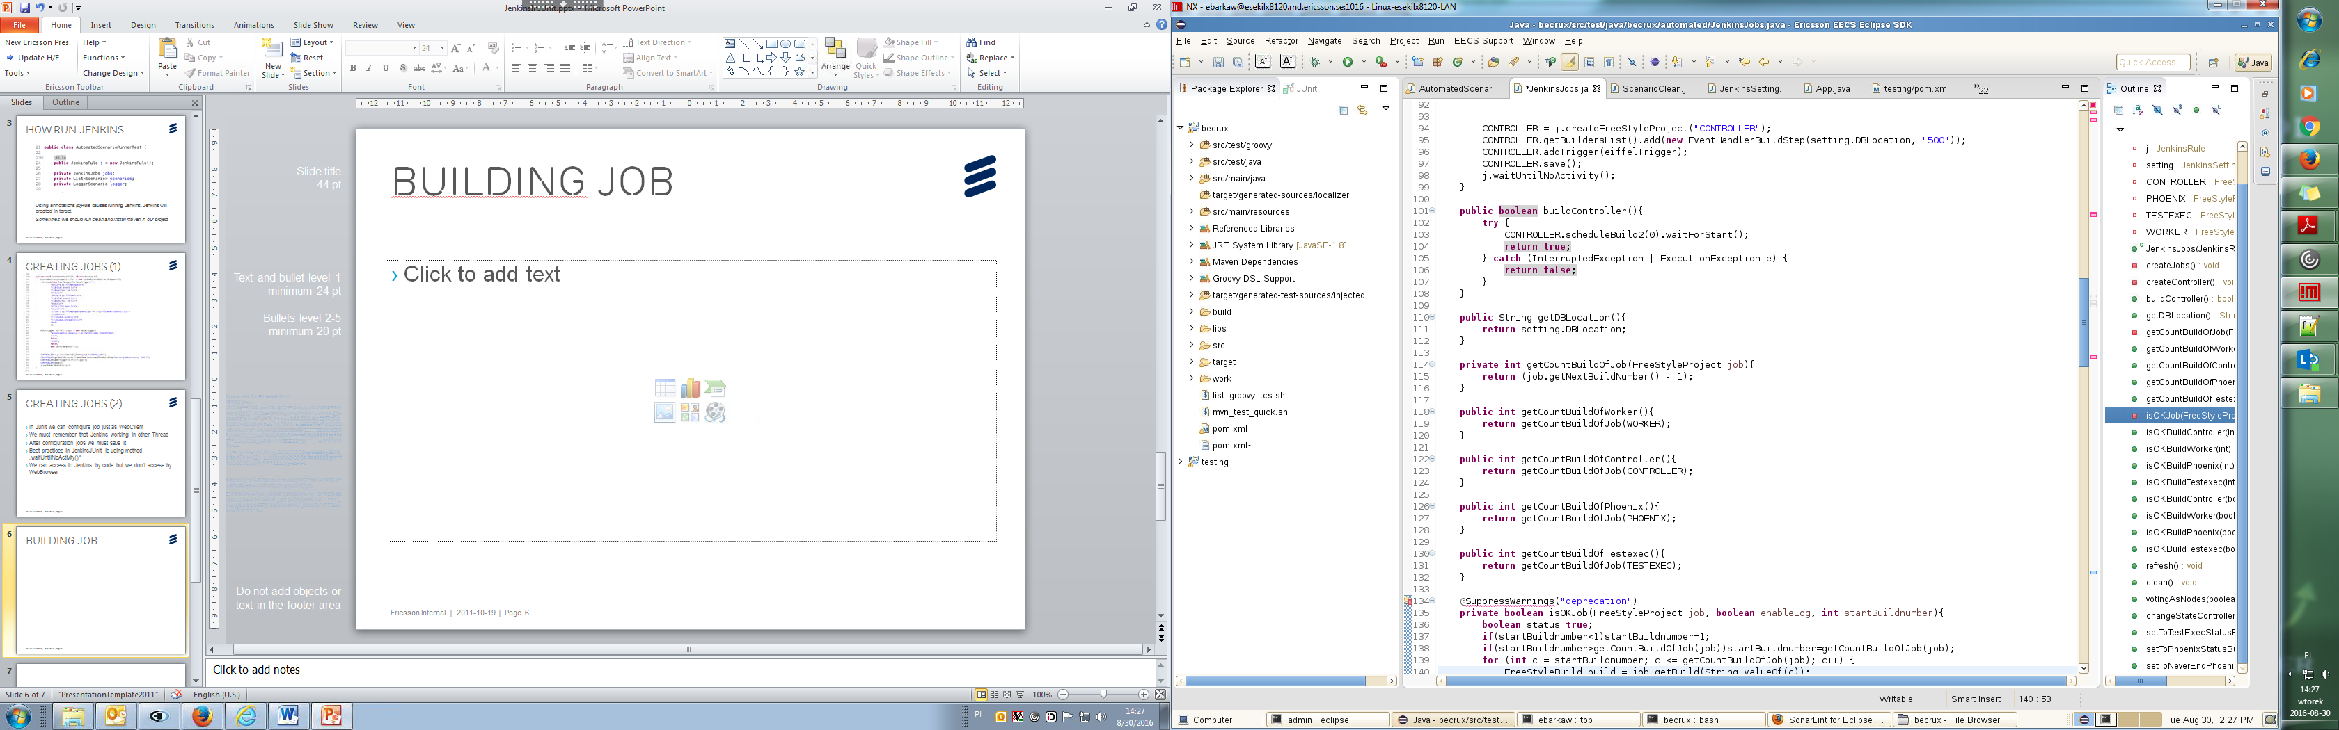
Building Job

Slide 8
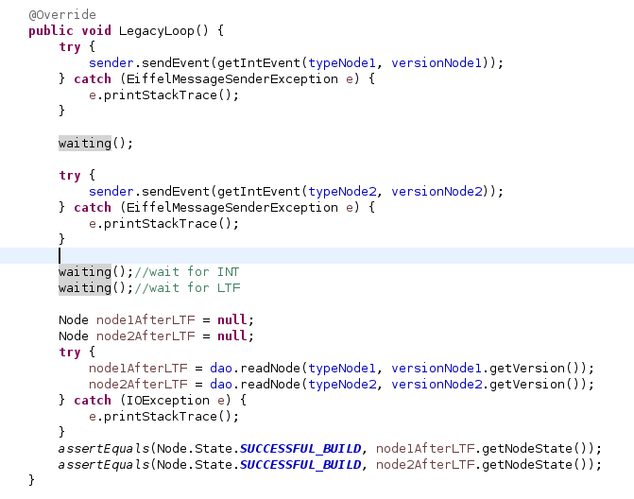
Verify Result

Slide 9

Problems
We are problem with Eiffel because we run more by one instance this product( we can run only one)
When doesn’t exist building project, somtimes JenkinsRule don’t find linking source in pom.xml

Slide 10

Benefits
We can very fast our CI project
We don’t have testing machine
We operate of data from project
We can compare all of part Jenkins, Jobs, Build ….
We can create a lot of scenario
Very friendly interface in Junit
We see Log from running system and very quicly repair that

